Slide 1


183 DB Weekly Report
Week 4 Team Parsley
Lin Li, Amir Omidfar, Wilson Chang, Angel Jimenez

Slide 2
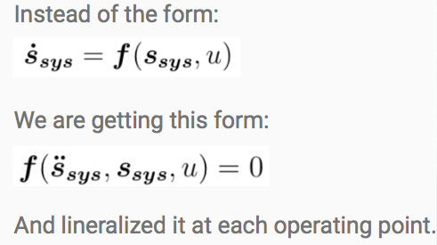
Mathematical Derivation

Slide 3

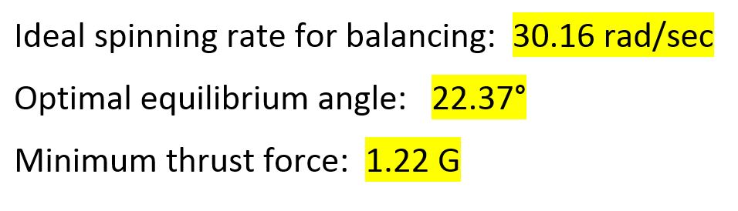
Mathematical Modeling and Simulation
Update
The key parameters that are obtained from the simulation

Slide 4
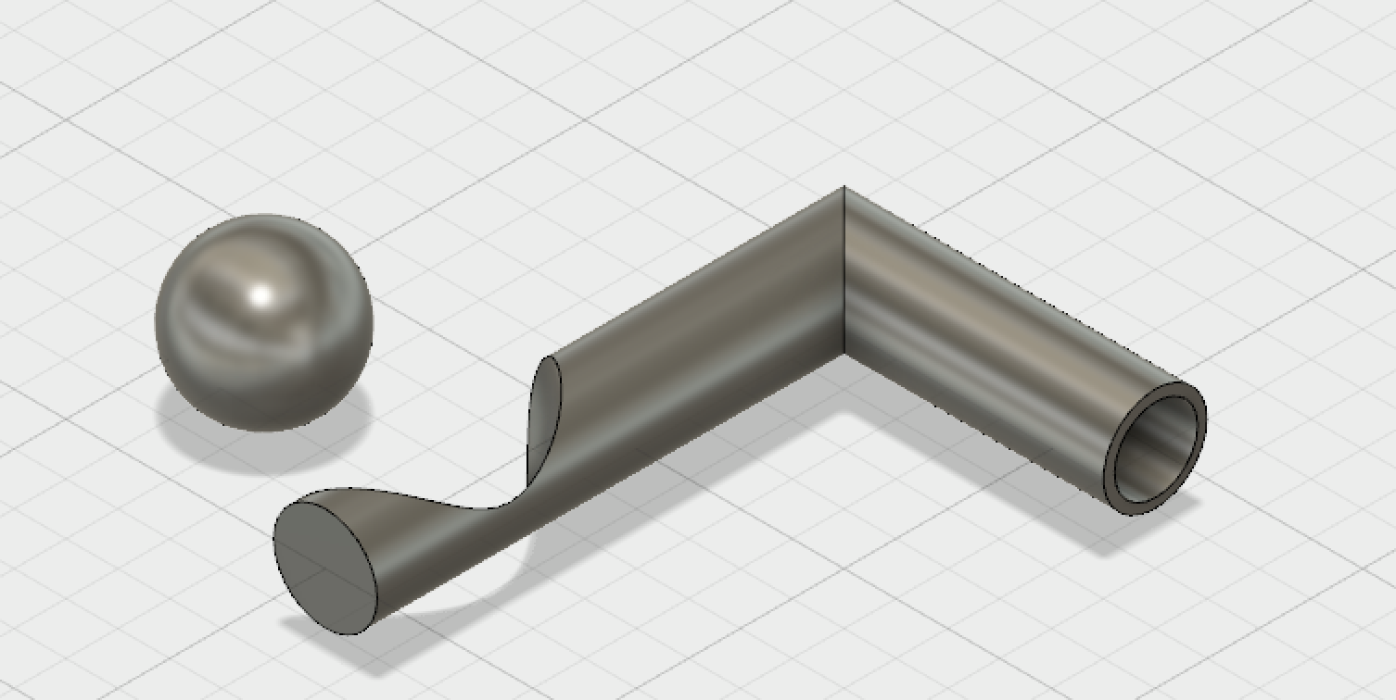
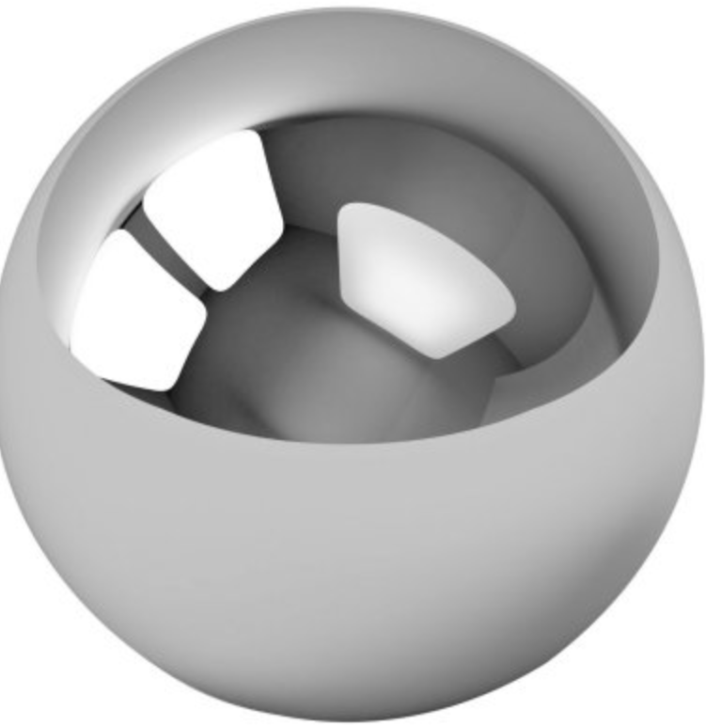
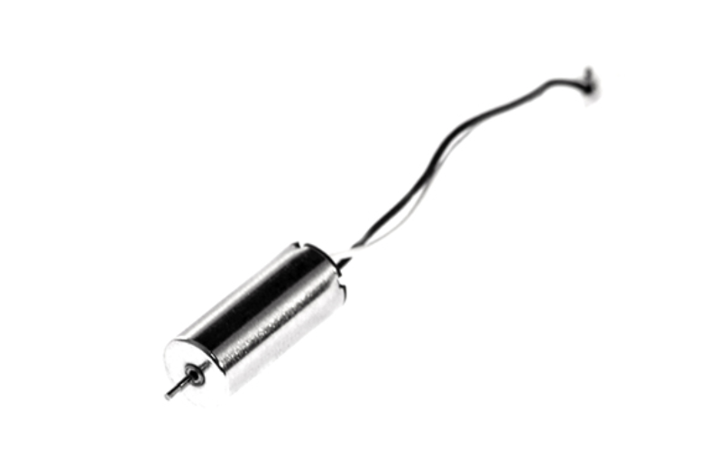
Off Center Spinning Mass Prototype
From Quadcopter Spec
Max Payload | 15 g
Motor weight | 2.7g
Spinning mass | <10g
Designed in Fusion 360
From Simulation Data
Spinning mass < 6g
Current and Power Calculation (Check rated info)
https://youtu.be/V58xpIB7BX8
→ motor can handle up to 20 g with 0.5v and (0.4 A current drawn)

Slide 5
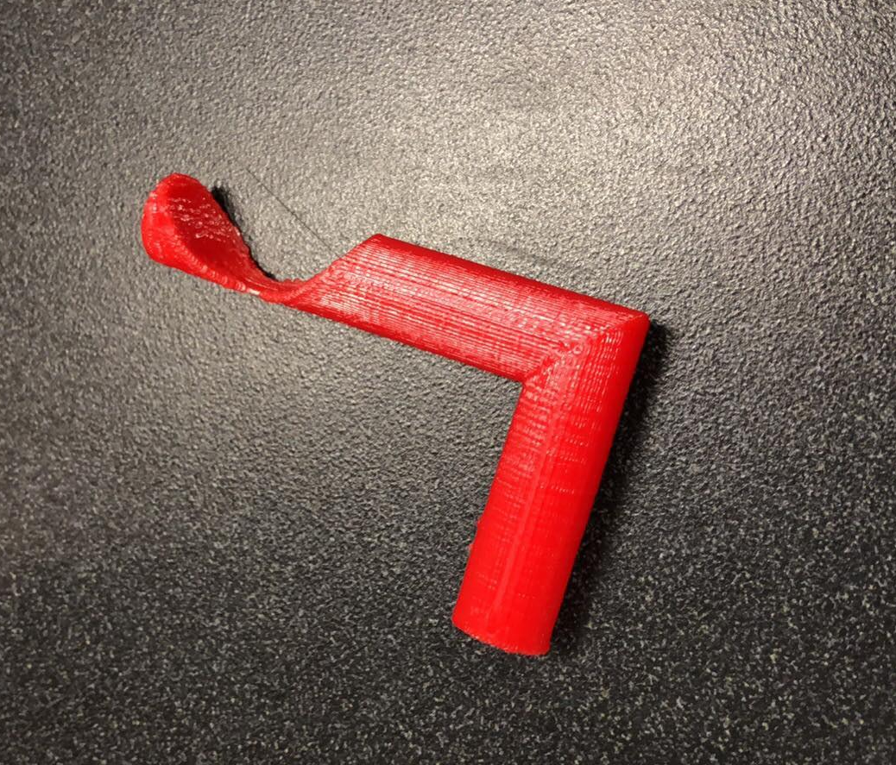
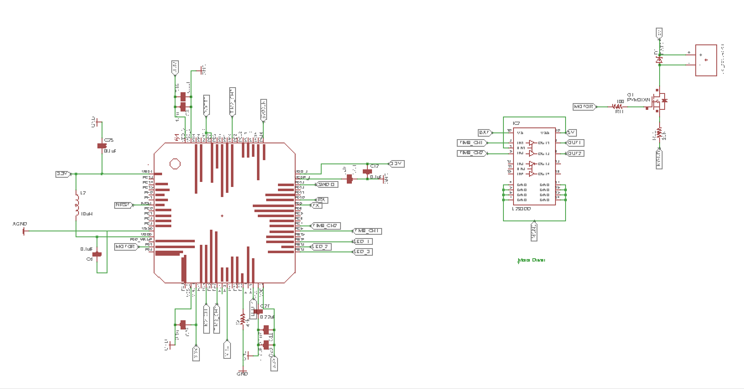
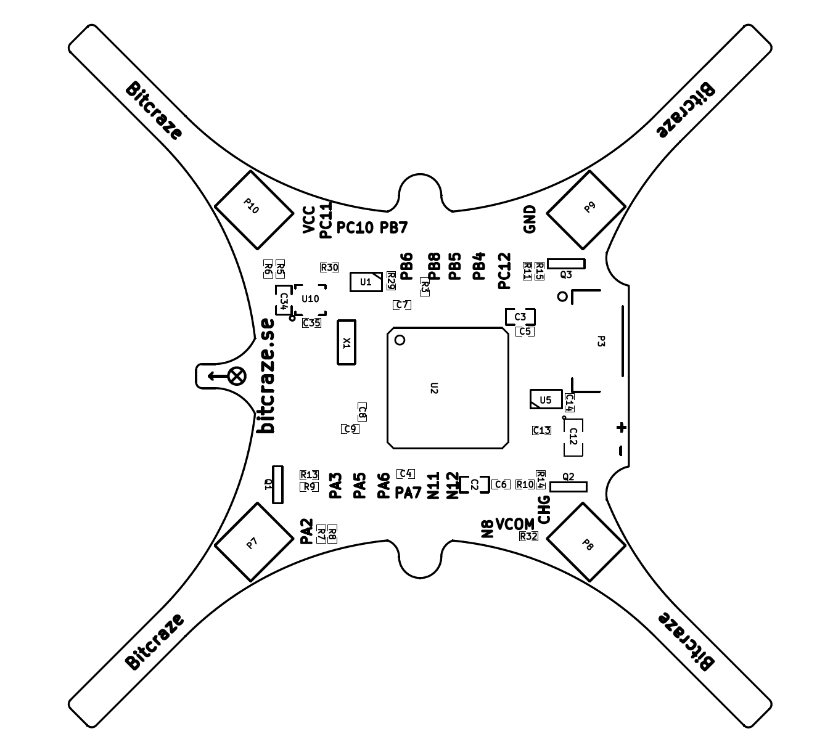
Off Center Spinning Mass Controller
Initial Prototype
Controller components
Crazyflie Component Placement
Encoder Motor

Slide 6
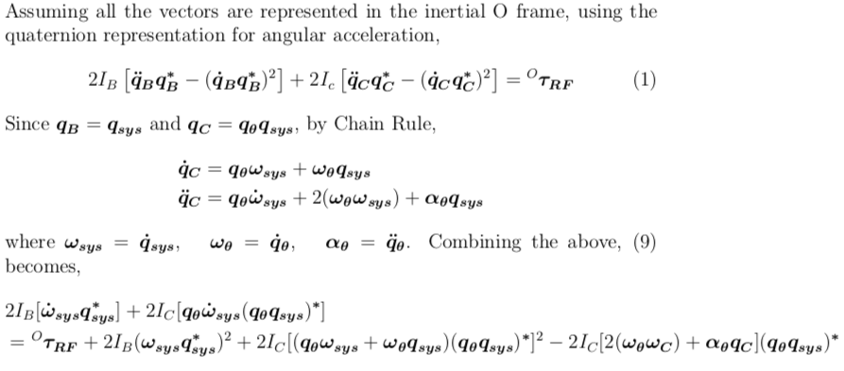
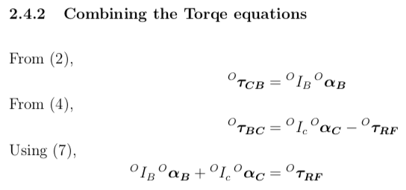
Documentation

Slide 7
Next Week Planning
Derive the right controller model to implement on the drone
Complete OCSM module which will be attached to our drone

